Slide 1
A Study on Data Visualization for Fishery Management
by Volodymyr Kozyr
B. Sc., Taras Schevchenko National University of Kyiv, 2017
School of Computing Science SIMON FRASER UNIVERSITY Fall 2021

Slide 2
Agenda
Introduction and main goals of the project
Related work
Problems and tasks identification
System overview
Data processing
Use cases implementation
Conclusions

Slide 3
Fishery Data Visualization
Challenge:
To make work involving data analysis faster and more productive for various users.
Topic:
To explore fishery data across time, and across space.
Objective:
To create a tool that can help fishery management to:
Regulate fishery catching in certain Canadian provinces.
Help to decide which policies or fishing quotas for specific fish types should be applied.

Slide 4
Related Work
Different groups of users in the fishery domain require different data sets.
Papers discussed in this chapter are oriented primarily for fishery management.
Primary goal of our work are:
Design and use of tools that will be easily accessible for fishery management users as it needs to have more charts, visualizations, etc. than other groups.
The tools need to support the decision-making process.

Slide 5
Related Work
FishCAM2000 (FC) is a computer-based integrated information system for fisheries management and marine environmental monitoring.
One important advantage of the system is that it presents complex geodata, which includes the amount of fish caught in the geographical zone (polygon area shapes with latitudes and longitudes as data points) on the map instead of the data table, which is a considerable timesaving for users to understand the query output.

Slide 6
Related Work

Slide 7
Related Work
IDMVis: is a visualization tool that shows multidimensional interrelated data during the day for patients with diabetes. The designed tool helps doctors track the state of patients' important parameters and detect anomalies.
Six clinicians evaluated design decisions positively. Detailed visualization convinces doctors to prescribe were more personalized treatment for the patient and helps with faster decision-making.

Slide 8
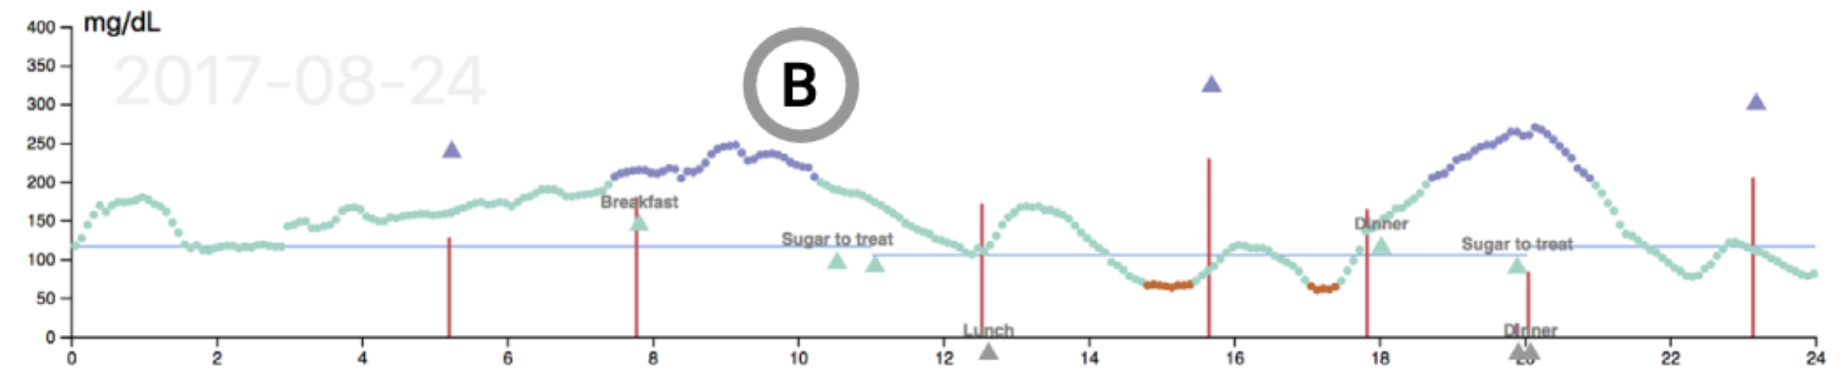
Related Work

Slide 9
Fishery Reports
The same approach of using line graph visualizations can be seen in a more recent annual environmental report on this kind of data.
Scottish Sea Fisheries Statistics for 2019 from the Cabinet Secretary for Rural Economic and Tourism provides summary data and more detailed statistics by region.

Slide 10
Fishery Reports
The total amount of fish caught (tonnage) is shown in blue, and the value of all landings by Scottish vessels is shown in red.
By comparing the blue and red lines, the user can easily and quickly determine the connection (will be discussed in the following chapter) between the catch's value and the amount of fish caught in a specific year.
For instance, the user can see that despite the tonnage falling since 2017, the value of landings remains constant.

Slide 11
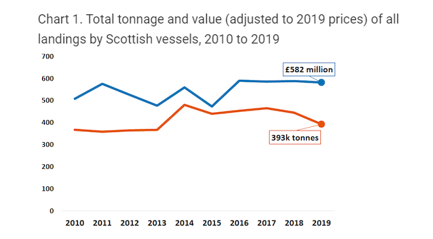
Fishery Reports

Slide 12
Fishery Reports
We can see that the marine industry requires to see overall reports on such parameters as “tonnage” and “value”.
From the pie charts, users can determine which type of fish gives which revenue according to tonnage.

Slide 13
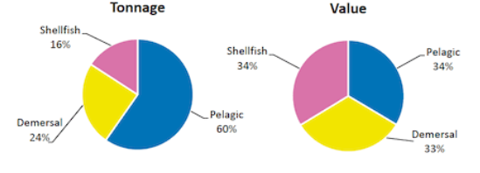
Fishery Reports

Slide 14
Fishery Reports
In the next report there are bar charts for two consecutive years presented.
This is done mainly to see trends and then to decide if the fishery industry is doing better or worse than the previous year.
After comparing values for two years some adjustments in fishery policies could potentially be implemented by ecologists or fishery companies.

Slide 15
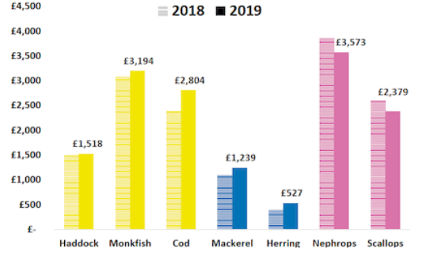
Fishery Reports

Slide 16
Fishery Domain Problems
Determining the optimal amount of catch for each type of fish to reduce environmental damage in a specific region.
Predicting which species may also be subject to negative or positive effects (trends).
Establishing quotas which will minimize the negative impact on the environment.
Analyzing the safety of methods for catching a particular type of fish in each region.
And other…

Slide 17
Visualization Motivation
Analysis of the data presented in a table or text format may take significant amount of time.
FishPlots is developed for people who may not be data scientists.
The main goal is to make it usable for people with average knowledge about computers.
No installation required as the tool accessible through URL in any modern browsers.
Another feature of FishPlots is that it will allow the user to select range, provinces, and any fish type from dropdowns, zoom into details, etc.

Slide 18
Visualization Requirements
Requirement 1. Interactivity
Requirement 2. Data Scaling for Further Analysis
Requirement 3. Summary and Overall Statistics

Slide 19
System Overview
FishPlots tool implemented through the web browser to allow the user to access the tool efficiently without the need of installation of additional of software.
FishPlots:
Written in TypeScript (wrapper for JavaScript) from Microsoft.
The front-end framework is Angular.
The back end is not required (test phase).
If the data source is changed, there will be minimum code modifications to get/process data.

Slide 20
System Overview
1) Data layer
Uses public data provided by DFO Canada.
Data is converted from Excel to JSON format.
The web browser gets data by using HTTP REST request.
Any web API can be used as a data source.
2) Logic Engine
Data-transformation from JSON files to a format.
FishPlots uses TypeScript framework Angular.
amCharts4 library included in the project for presenting data.
3) User interface overview
The date range slider (from 1990 to 2018).
There are two multiple selection pickers for provinces and fish types which are also filtering data.
Based on the user input, there may be 4 different visualizations generated.

Slide 21
System Overview

Slide 22
Task 1. Exploring Relationships for Fish Amount and Price
Visualization 1:
Multiline chart
Color-coding
Legends for data filtering
Features:
Presents the information to include multiple values for data analysis.
Easy to follow and use for further deep data investigation.
Ability to explore a yearly trend.
The adaptivity of the chart makes the data processing efficient by providing a way to work with data from multiple regions and years simultaneously.

Slide 23
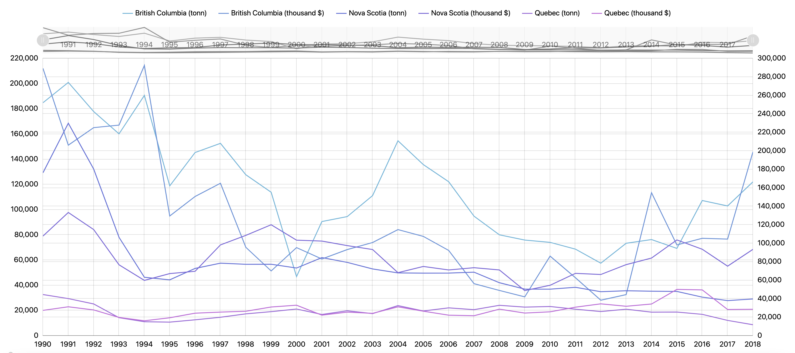
Task 1. Exploring Relationships for Fish Amount and Price

Slide 24
Task 2. Paired Time Series for Fish Amount and Price
Visualization 2:
Scatter plot
Bullet points and labels represent years
Features:
Presents the ability to analyze and compare data efficiently by visualizing multiple values simultaneously.
The chart allows us to quickly understand the trend over the years and build analysis on the selected fishery market.
The chart could be expanded to show more than one type of fish.

Slide 25
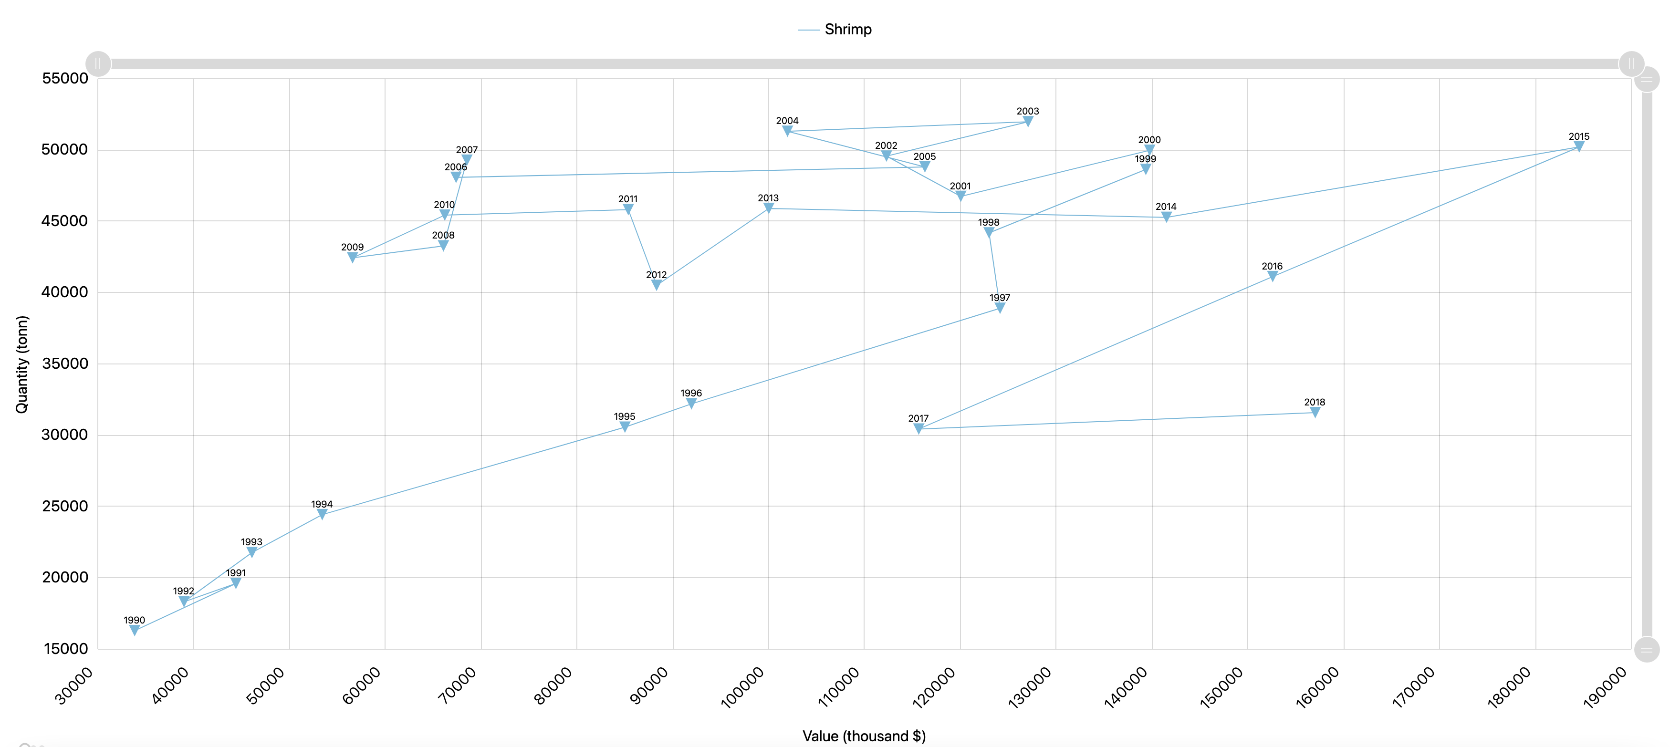
Task 2. Paired Time Series for Fish Amount and Price

Slide 26
Task 3. Identifying Top Fish Species by Catch Amount or Price
Visualization 3:
Pie-chart
Number of legends is adapted depending on the top values per the selected year
Yearly Comprising
Features:
FishPlots would sort and group the value ($) or catch quantities (tons) of fish types and assign the applicable percentage per type.
2 charts presented simultaneously.
Top fish types are separated into their own sections, and the rest is grouped into “other”.
When “Other” chosen, drills down to see the “outliers” in the dataset details.

Slide 27
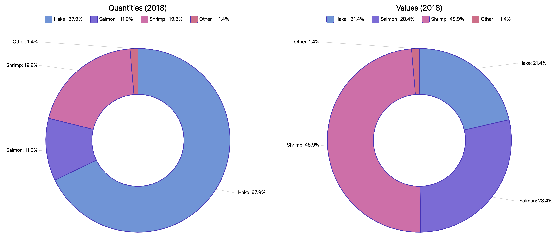
Task 3. Identifying Top Fish Species by Catch Amount or Price

Slide 28
Task 4. Consequent Years Fishery Data Comparison
Visualization 4
Improved categorized bar chart
Features
Compares and analyze the data between the selected years quickly and easily.
Particularly useful for determining trends for the current and previous year.

Slide 29
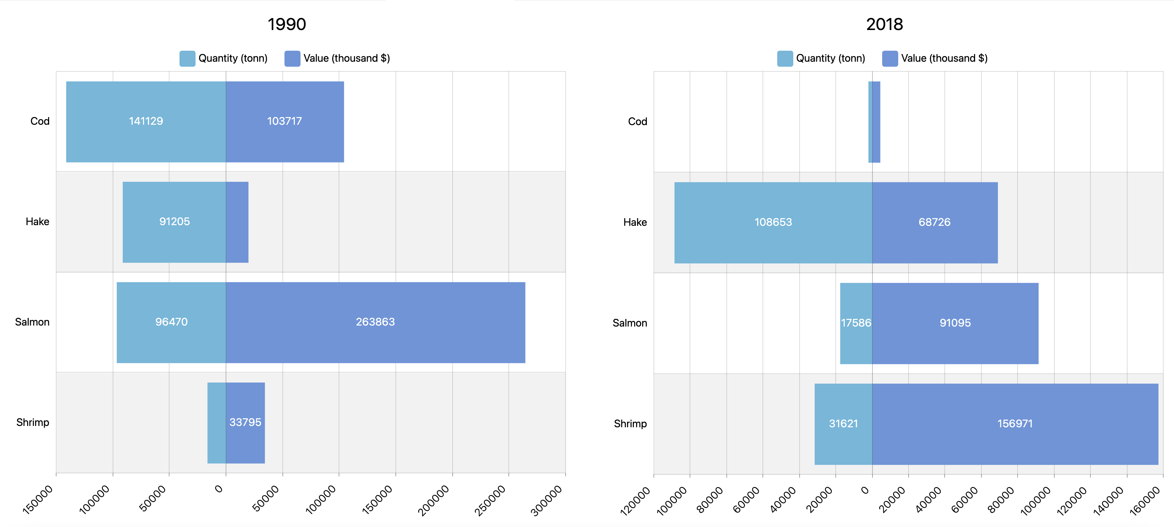
Task 4. Consequent Years Fishery Data Comparison

Slide 30
Conclusions and Future Work
Task 1:
Explore relations between fish values and amounts.
The ability to select/deselect fish types/provinces, zoom feature which allows users to see data for smaller date range without a need to re-render visualization.
Task 2:
A scatter plot, which combines 3 dimensions: value, amount, year.
Using this chart, the user can see trends of the value/amount ratio for different fish types.
Task 3:
Pie charts in task 3 show data like they are used for report summary.
The grouping feature.
Task 4:
Bar charts allows comparison of summary data for any two selected years.
Showing different dimensions on the same axis.

Slide 31
Conclusions and Future Work
Bringing more data sources that could provide broader and more unbiased knowledge of the problem the user is trying to investigate.
Saving visualization state would be beneficial for users as they could share and discuss their visualizations without a need to re-apply settings.
Synchronization of new data from the sources (REST approach).

